Slide 1

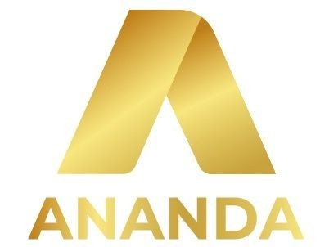
The Cryptocurrency Trading Challenge
OPIM 5770 Advanced Business Analytics and Project Management
A Comprehensive Solution for Cryptocurrency Trading
By Team-4
Professor : Dr. Sudip Bhattacharjee
sudip.bhattacharjee@uconn.edu
Sponsor : Kosh Suchak, kosh@ananda.trade
Pat McCarthy, pat@ananda.trade

Slide 2









Meet our Team
Aravind(SL) aravind_reddy.datla@uconn.edu
Pramod (PM)
pramod_Chakravarthy.kandula@uconn.edu
Revanth revanth_goud.gaja gauni@uconn.edu
Sruthilaya sruthilaya.dara@ uconn.edu
Himavanth himavanth.anant hula@uconn.edu
Usha Sree usha_sree.dindi @uconn.edu
Navya navya.vaddavalli @uconn.edu
Yaswanth yashwanth_aniru dh.ettikala@uco nn.edu
Manikanta manikanta.2.chin ta@uconn.edu

Slide 3

Shaping the Next Generation of User Interaction
Chatbots FOR Cryptocurrency

Slide 4


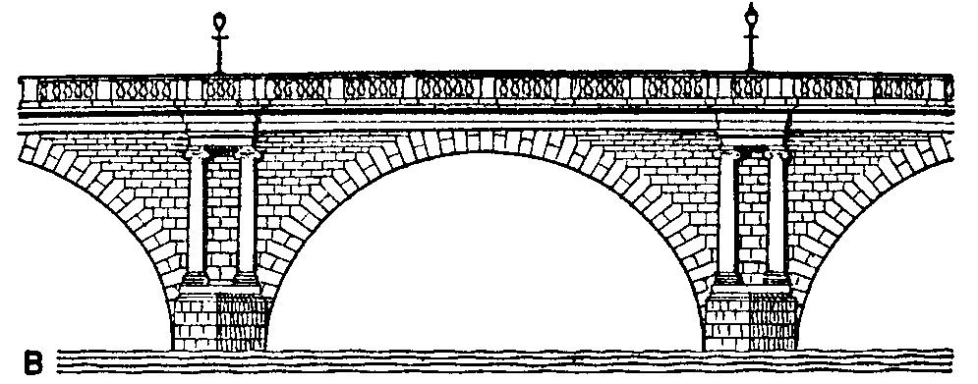
Role of CHATBOT
Problem statement
Cryptocurrency markets are volatile and require quick reactions, but many platforms lack effective tools for analyzing data and providing actionable insights, leaving traders unsupported
“Let's bridge the gap between data and decisions with advanced, real-time analytics tailored for the crypto market.”
Chatbot

Slide 5
The Power Behind Our Chatbot: Open- source LLMs
Llama: Known for its efficiency in smaller environments; suitable for lightweight deployment.
Gemma: Excels in multilingual support, key for diverse user bases in crypto.
Mistral7B: Offers a balance of performance and memory efficiency, optimized for chatbots.

Slide 6
Building Intelligence: Training and Fine- tuning the LLMs
•
Data sources: Crypto forums, Crypto market analysis reports, trading surveys, technical research papers, regulatory insights, transaction logs, market trends, Standard answers for some questions related to cryptocurrency provided by the sponsor.
•
Emphasis on fine-tuning LLMs with domain-specific data to handle complex queries about cryptocurrency.
•
Challenges: Ensuring relevance, minimizing bias in financial predictions.
•
The importance of iteration: refining performance over multiple test cases.

Slide 7
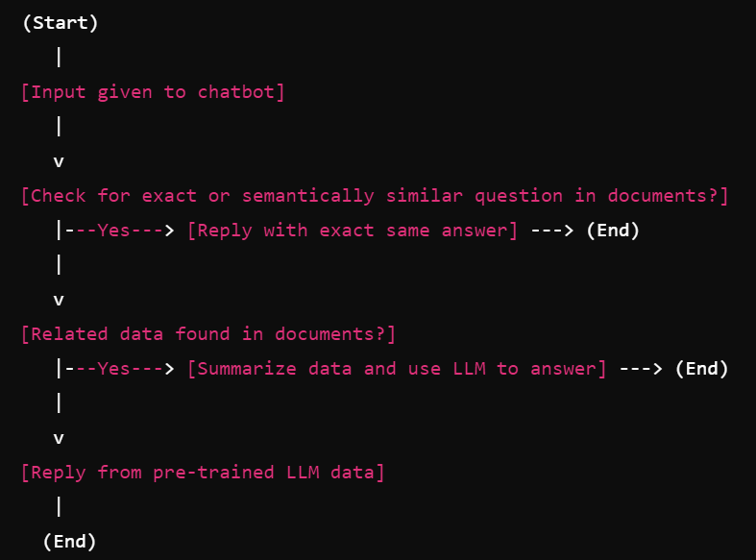
Integrating RAG for Advanced Performance
•
RAG integrates information retrieval with LLMs to provide real-time responses.
•
Ensures the chatbot provides factual, up-to-date information by fetching data.
Reduces the risk of hallucination by grounding responses in real-world information.
RAG benefits include improved chatbot accuracy and trustworthiness in complex scenarios like crypto analysis.

Slide 8
EVALUATION METRICS
WEIGHTS (100%)
BLEU (Bilingual Evaluation Understudy Score): It focuses on exact word matches and can be too rigid for tasks requiring nuance in language generation.
higher scores indicate closer lexical similarity.
ROUGE (Recall-Oriented Understudy for Gisting Evaluation): It evaluates how well a generated text captures the essence of reference text, focusing on recall and content overlap.
• BERT Score: It uses contextual embeddings to capture semantic similarities, focusing on meaning rather than mere word overlap.
• Cosine Similarity (Embedding): It determines how closely two embedding vectors align in a high-dimensional space, reflecting their semantic or contextual similarity.
BLEU- 10%
ROUGE1 - 20%
ROUGE2 – 25%
ROUGEL – 25%
BERT Score - 15%
Cosine - 5%

Slide 9
T Stat -How MODELS are significantly different?
Category | Comparison | Statistic | P-Value | Insight
Within LLMs (With vs Without RAG) | LlamaBase vs Llama_RAG | -9.03 | < 0.00001 | RAG significantly improves performance
Cross-LLM Comparisons (Without RAG) | Mistral_Base vs LlamaBase | 6.96 | < 0.00001 | Mistral_Base outperforms LlamaBase significantly
Cross-LLM Comparisons (With RAG) | Llama_RAG vs Gemma_RAG | 3.93 | 0.00012 | Llama_RAG outperforms Gemma_RAG significantly
Non-significant Results (RAG Comparisons) | Mistral_RAG vs Llama_RAG Gemma_Base vs Gemma_RAG | -0.84 -0.78 | 0.402 0.436 | No significant difference between Mistral_RAG and Llama_RAG; both effectively use RAG.No significant RAG impact on Gemma; potential misalignment with model capabilities or training context.
Models | T statistic value | P value | Better Model
Llama Base vs Llama RAG | -9.03 | <0.0001 | Llama RAG
Gemma Base vs Gemma RAG | -0.78 | 0.436 | Gemma RAG
Mistral Base vs Mistral RAG | -2.11 | 0.036 | Mistral RAG
Llama Base vs Gemma Base | -5.58 | <0.0001 | Llama Base
Gemma Base vs Mistral Base | -2.29 | 0.0231 | Mistral Base
Mistral Base vs Llama Base | 6.96 | <0.0001 | Mistral Base
Llama RAG vs Gemma RAG | 3.93 | 0.00012 | Llama RAG
Gemma RAG vs Mistral RAG | -2.95 | 0.0035 | Mistral RAG
Mistral RAG vs Llama RAG | -0.84 | 0.402 | Llama RAG

Slide 10
Business Implications of Model Performance
Assumption | Details
Cost per Billion Parameters | 10 units/hour per billion parameters
RAG Cost Increase | Fixed 20% increase over Base model operational cost
Llama Parameters | 70 billion
Mistral Parameters | 7 billion
Gemma Parameters | 9 billion
Statistical Significance Threshold | p < 0.05 indicates statistically significant improvement
Performance Evaluation | Improvements measured in accuracy and other task-specific metrics (e.g., precision, recall)
Negligible Performance | No meaningful improvement despite p > 0.05
Model | Weighted Avg
Llama_Base | 0.2385
Llama_RAG | 0.2993
Gemma_Base | 0.2636
Gemma_RAG | 0.2684
Mistral_Base | 0.2761
Mistral_RAG | 0.2921
Example: Llama Base vs. Llama RAG
Weighted Avg (Base): 0.2385
Weighted Avg (RAG): 0.2993
Cost : Llama 70b x 10= 700 units per hr
Cost : Llama RAG = 700+20%(700) units/hr
Accuracy :
abs(0.2385 – 0.2993 / 0.2385)X100
= 24.5%
Accuracy Gain (%)=Weighted Avg (Model 1) - Weighted Avg (Model 2)/Weighted Avg (Model 1)​×100
Cost Increase (%)=Fixed Percentage Increase (RAG)=20%

Slide 11
Business Implications of Model Performance
Model Pair | T-statistic (Evidence) | Performance Gain | Cost Difference | Business Recommendation
Llama Base vs. RAG | -9.03 (p < 0.001) | 25.5%( Llama RAG Higher) | +20% operational cost | Adopt for high-accuracy, mission-critical applications.
Mistral Base vs. RAG | -2.11 (p = 0.036) | 5.8% (Mistral RAG Higher) | +20% operational cost | Use for moderate-scale, cost-sensitive tasks.
Gemma Base vs. RAG | -0.78 (p = 0.436) | Negligible (~2%) (Gemma RAG Higher) | +20% operational cost | Retain Base for cost savings; RAG improvement not justified.
Gemma RAG vs. Mistral RAG | -2.95 (p = 0.0035) | 9.1% (Mistral RAG Higher) | Comparable costs | Use Mistral RAG for better performance and cost efficiency.
Mistral Base vs. Llama Base | 6.96 (p = 5.45e-11) | 15.8% (Mistral higher) | 10× higher cost (Llama) | Use Mistral Base for applications having low operational costs and high efficiency
Llama RAG vs. Mistral RAG | -0.84 (p = 0.402) | Negligible (<2%) (Llama RAG Higher) | 10× higher cost (Llama) | Use Mistral RAG for cost-effective performance where budget is constrained.

Slide 12
Conclusion
Llama RAG is the top choice for high-accuracy, mission-critical tasks, justifying a 20% operational cost increase for applications demanding precision.
Mistral RAG is the most cost-effective option for moderate to high-performance needs.
Gemma Base should be retained for low-cost scenarios where performance gains from RAG are negligible, while Mistral Base outperforms Gemma Base at similar costs, offering better value for moderate tasks.

Slide 13
THANK YOU!

